Slide 1
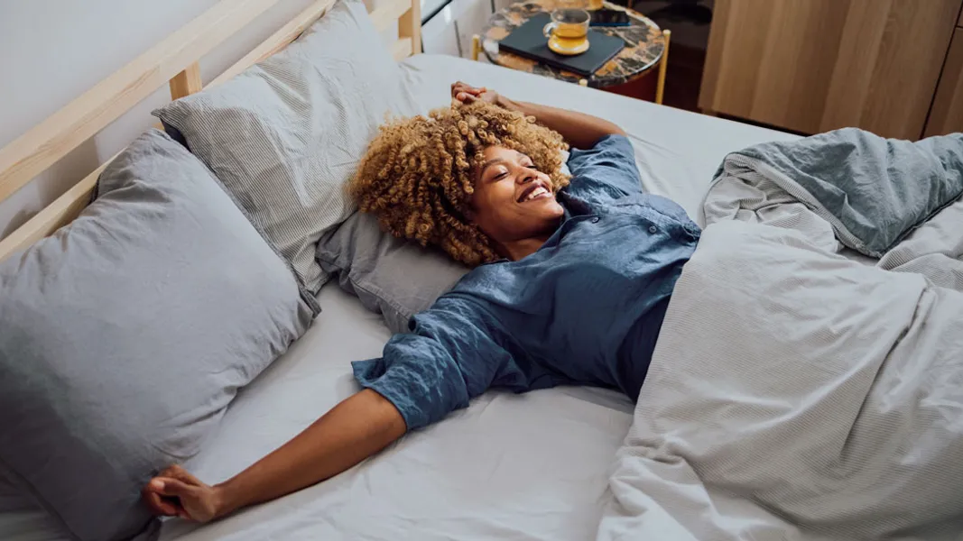
How to spring-proof your health when the clocks go forward
Expert tips for minimising the impact on your sleep and routine, and prepping kids and pets for when British Summer Time begins

Slide 2
The clocks 'spring forward' an hour at 1am on Sunday 30 March 2025, marking the start of British Summer Time and lighter, longer days.
While the approach of spring is welcome after a long cold winter, the shift in time impacts our internal body clock, and some studies have shown it can increase the risk of serious health incidents in the day or two after, including heart attack or stroke.
Other studies have noted a rise in vehicle accidents and accidents at work just after the switch.
Russell Foster, professor of circadian neuroscience at the University of Oxford, says that for most of us this 'social jetlag' does little more than leave us temporarily out of sorts.
However, there are simple steps you can take to minimise the impact, and for those with children or pets in particular it's worth thinking ahead to avoid disruption and ease the transition.

Slide 3
Adjust your bedtime a few nights beforehand
Professor Foster says: 'If you typically already get enough sleep, having your sleep temporarily disrupted will be an irritation, but for those who are chronically sleep deprived or have chronic health conditions, it can be significantly worse.'
In the days running up to the clocks going forward, adjust your bedtime by about 10-15 minutes earlier each day (or half an hour each on the Friday and Saturday before the change) to help your body to adjust to the new schedule more gently.
Being anxious about not getting enough sleep can be counterproductive and stop you sleeping altogether, so don't panic – your body will adjust over time.

Slide 4
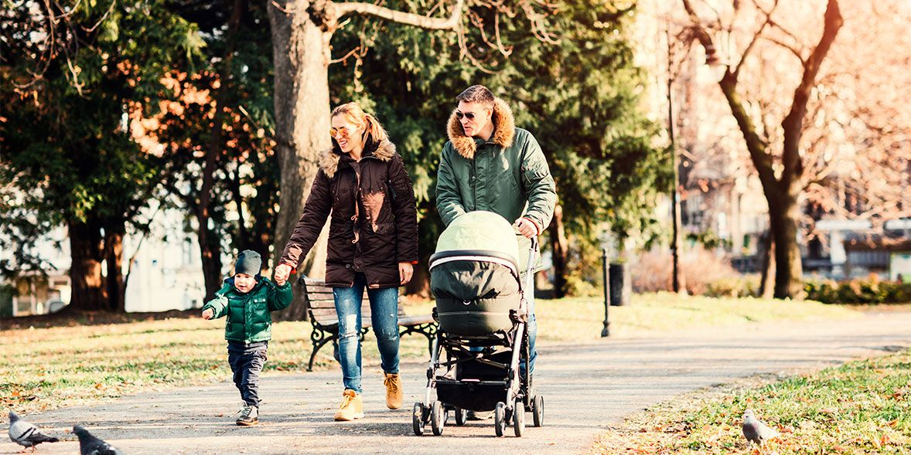
Get out for a morning walk
Light hitting the back of your eyes, then sending it to the brain, is the most powerful regulator of your body clock, so although you may be tempted to sleep in on Sunday morning, getting out of the house for a walk in daylight first thing is one of the best things you can do.
You need relatively bright light, in the 100-1,000 lux range, for at least 30 minutes to properly shift your body clock to the new regime (domestic lighting is 100-200 lux, so not strong enough) and early in the day is best.
This will help you feel sleepier earlier, and an earlier bedtime will help you tank up on sleep. This applies to kids and pets too.

Slide 5
Prep kids and teens
Children young enough to be put to bed by you can follow the same pattern that you do, moving their bedtime by a few minutes each night. Blackout curtains or blinds will help ensure that lighter evenings don't keep them up.
Teenagers can be trickier, because they are biologically programmed to go to sleep later and wake up later (if allowed to!). Foster says it's worth trying to encourage them to switch off devices at least 30 minutes before bedtime, because studies have shown that late-night tech use increases brain alertness and delays sleep.

Slide 6
Don't forget pets
Youngsters aren't the only ones whose internal clock can be confused by the time difference: dogs rely on a routine in their daily lives, too, from mealtimes and walks to when they go to sleep for the night.
Chloe Jackson, canine behavior and training manager at Battersea dog and cat rehoming centre, says: 'Things that can have an impact on your pet’s routine, from major events such as a change in shift patterns to more minor events such as clocks changing, can be confusing and stressful for them.'
To help minimise disruption to their routine, try to adjust their feeding time and bedtime gradually over a few days before the clocks change – perhaps aligning them to changes to your own routine – and take them out for a morning walk on Sunday to reset their circadian system, too.

Slide 7
Don't nap too much to catch up
If you're struggling to keep your eyes open in the daytime following the time change, grab a nap if you can, but limit it to 20 minutes max or you'll potentially fall into a deeper sleep and feel even more groggy and less alert when you wake up.
Napping too close to bedtime should be avoided, too, as this can reduce your body's drive to sleep at the correct time, resulting in a vicious cycle (napping late, falling asleep late, being tired the next day, on repeat) that leaves your body clock out of sync with everybody else. Aim to ensure any nap is more than six hours before bedtime.

Slide 8
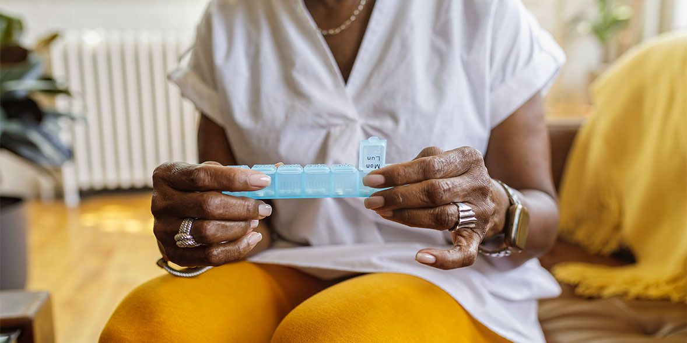
Check your medication
Some prescription medication needs to be taken a certain way to make sure it is safe or works effectively, such as taking it at the same time each day: for example, the 'mini' (progesterone-only) pill and some drugs used for treating high blood pressure, epilepsy and Parkinson's.
Don't worry too much, though. Wing Tang, head of professional standards at the Royal Pharmaceutical Society, says they wouldn't typically expect the clocks going forward to have a great impact on people taking regular medicines.
It's worth ensuring you're on top of any drugs that can make you sleepy and are taken ahead of bedtime, such as amytriptyline for migraines. Setting an alarm to remind you to take them can help you keep on track.

Slide 9
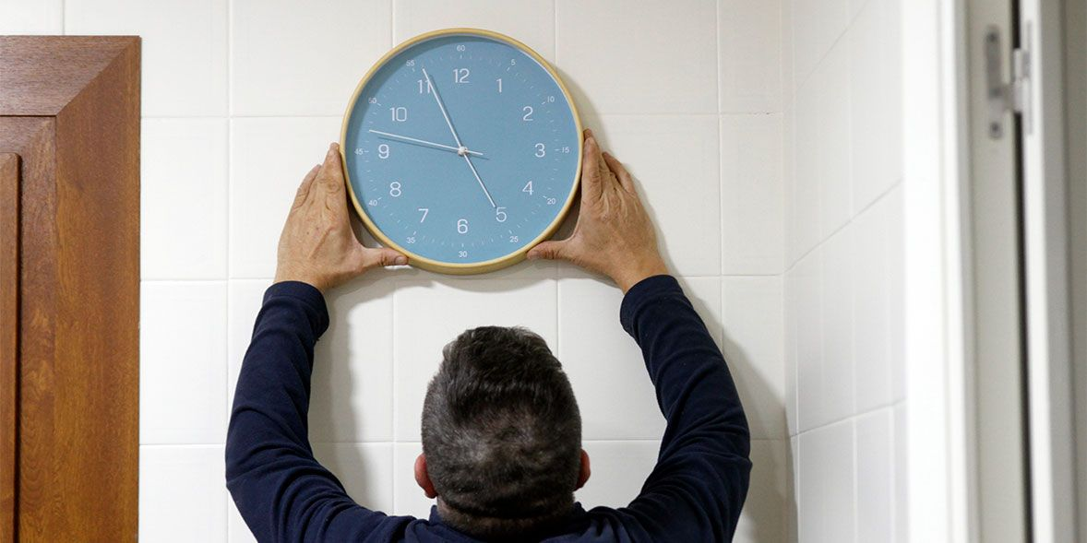
Get your house in order
Even if you don't own an actual clock, your home is still likely to be full of them, whether it's on smartphones, computers or smartwatches, ovens, microwaves or boilers.
Many will change to the new time by themselves, while some appliances or older products will need to be manually adjusted – and if you don't do this you could add to your stress by not waking up on time or turning up late to appointments.

Slide 10
Appliances that change by themselves
These typically include anything that's connected to the internet, such as:
smartphones, smart TVs, smartwatches, smart security systems, smart plugs and smart thermostats
radio-controlled or digital versions of clocks, radios, radio alarm clocks and watches

Slide 11
Appliances that need to be manually adjusted forwards
These include analogue clocks, alarm clocks and watches, and appliances such as:
older central heating controls and hot-water timers
ovens and microwaves
car clocks (especially in older cars)

